Slide 1


Deploy ASP.Net Website on IIS in Our Local Machine

Slide 2
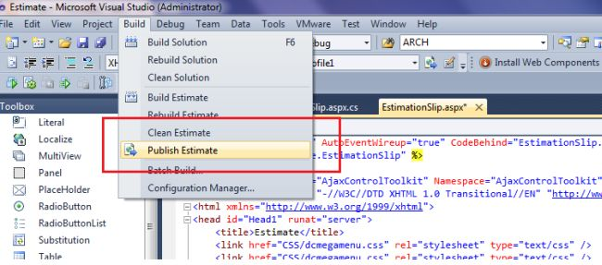
Deploy ASP.Net Website on IIS in Our Local Machine
First open your ASP.Net web application in Visual Studio.
Now in the top we have the option Build. Click on that and under Build you will find Publish Website.
Publish Website

Slide 3
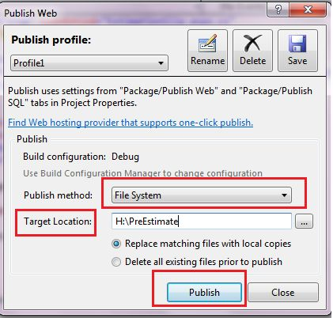
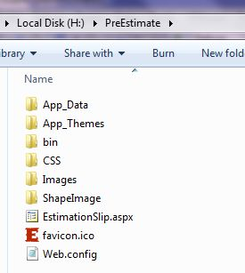
Deploy ASP.Net Website on IIS in Our Local Machine
Click on Publish Website. Now open the publish web pop-up.
For Publish method select File System.
For Target location specify where to save your web application DLL file.
click on publish
Then click on publish.
Go to the target folder and in that location, you will see your web application DLL file.

Slide 4
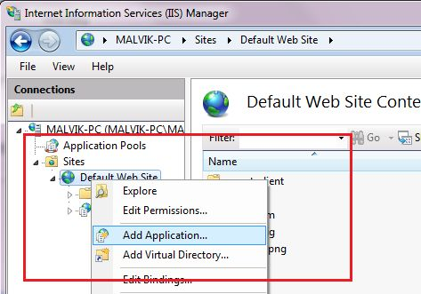
Deploy ASP.Net Website on IIS in Our Local Machine
Now open IIS manager. (Type inetmgr in the Run command.)
Right-click on Default Application and Add Application.

Slide 5
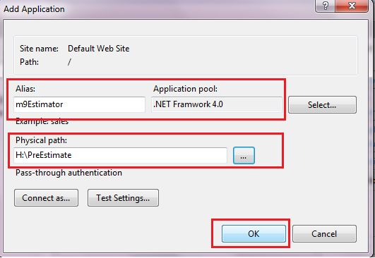
Deploy ASP.Net Website on IIS in Our Local Machine
Enter Alias name then select an Application pool and Physical path.

Slide 6
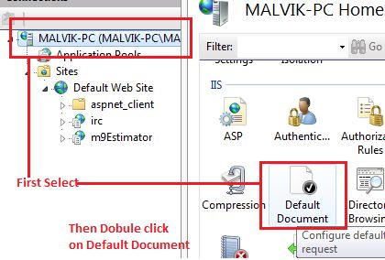
Deploy ASP.Net Website on IIS in Our Local Machine
Now Double-click on default document.

Slide 7
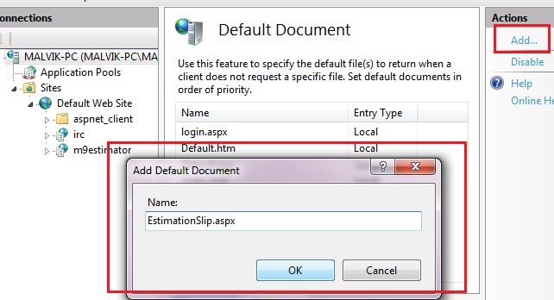
Deploy ASP.Net Website on IIS in Our Local Machine
And add a start page of your web application. Here my application start page is EstimationSlip.aspx.

Slide 8
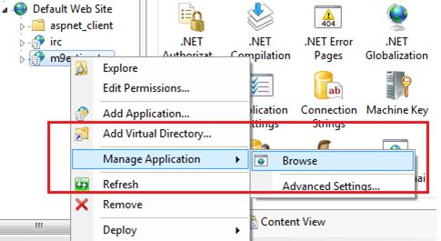
Deploy ASP.Net Website on IIS in Our Local Machine
Now right-click on your application and browse.

Slide 9
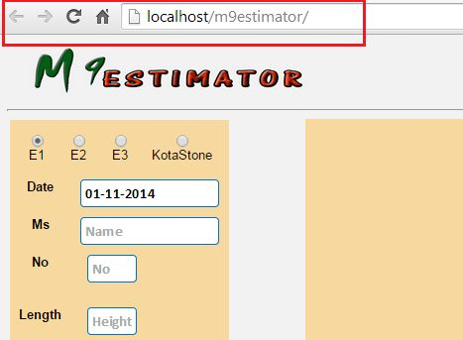
Deploy ASP.Net Website on IIS in Our Local Machine
See your application without Visual Studio.

Slide 10
Thank You

